Slide 1



TITLE
A MINOR PROJECT-I REPORT
Submitted by
DHARSHINI B (22BEC037)
DHARSHNA R (22BEC040)
DEVAKI M (22BEC030)
DHARSINI DEVI R V (22BEC042)
BACHELOR OF ENGINEERING
in
DEPARTMENT OF ELECTRONICS AND COMMUNICATION ENGINEERING
M.KUMARASAMY COLLEGE OF ENGINEERING
(Autonomous)
KARUR – 639 113
DECEMBER 2023
Page1

Slide 2
M.KUMARASAMY COLLEGE OF ENGINEERING, KARUR
BONAFIDE CERTIFICATE
Certified that this 180-Minor Project I report “SMART WATER LEVEL MONITORING SYSTEM” is the bonafide work of “DHARSHINI B (22BEC037), DHARSINI DEVI R V(22BEC042), DEVAKI M(22BEC030) DHARSHNA R(22BEC040) ” who carried out the project work under my supervision in the academic year 2023-2024.
SIGNATURE
Dr.A.Kavitha, M.E., Ph.D.,
HEAD OF THE DEPARTMENT,
Professor,
Department of Electronics and Communication Engineering,
M. Kumarasamy College of Engineering, Thalavapalayam, Karur-639113.
SIGNATURE
MRS. P.YUVARANI, M.E;(PHD)
SUPERVISOR,
Assistant Professor,
Department of Electronics and Communication Engineering, M.Kumarasamy College of Engineering, Thalavapalayam, Karur-639113.
This Minor project-I report has been submitted for the 18L – Minor Project-I Review
held at M. Kumarasamy College of Engineering, Karur on .
PROJECT COORDINATOR
Page2

Slide 3
Vision of the Institution
To emerge as a leader among the top institutions in the field of technical education
Mission of the Institution
M1: Produce smart technocrats with empirical knowledge who can surmount the global challenges
M2: Create a diverse, fully engaged, learner-centric campus environment to provide quality education to the students
M3: Maintain mutually beneficial partnerships with our alumni, industry, and Professional associations Vision of the Department
Vision of the Department
To empower the Electronics and Communication Engineering students with emerging technologies, professionalism, innovative research, and social responsibility.
Mission of the Department
M1: Attain the academic excellence through innovative teaching learning process, research areas & laboratories and Consultancy projects.
M2: Inculcate the students in problem solving and lifelong learning ability.
M3: Provide entrepreneurial skills and leadership qualities.
M4: Render the technical knowledge and skills of faculty members.
Page3

Slide 4
Program Educational Objectives (PEOs):
PEO1: Core Competence: Graduates will have a successful career in academia or industry associated with Electronics and Communication Engineering.
PEO2: Professionalism: Graduates will provide feasible solutions for the challenging problems through comprehensive research and innovation in the allied areas of Electronics and Communication Engineering.
PEO3: Lifelong Learning: Graduates will contribute to the social needs through lifelong learning, practicing professional ethics and leadership quality
Program Outcomes (POs):
PO 1: Engineering knowledge: Apply the knowledge of mathematics, science, engineering fundamentals, and an engineering specialization to the solution of complex engineering problems.
PO 2: Problem analysis: Identify, formulate, review research literature, and analyze complex engineering problems reaching substantiated conclusions using first principles of mathematics, natural sciences, and engineering sciences.
PO 3: Design/development of solutions: Design solutions for complex engineering problems and design system components or processes that meet the specified needs with appropriate consideration for the public health and safety, and the cultural, societal, and environmental considerations.
PO 4: Conduct investigations of complex problems: Use research-based knowledge and research methods including design of experiments, analysis and interpretation of data, and synthesis of the information to provide valid conclusions.
PO 5: Modern tool usage: Create, select, and apply appropriate techniques, resources, and modern engineering and IT tools including prediction and modeling to complex engineering activities with an understanding of the limitations.
PO 6: The engineer and society: Apply reasoning informed by the contextual knowledge to assess societal, health, safety, legal and cultural issues, and the consequent responsibilities relevant to the professional engineering practice.
Page4
P

Slide 5
PO 7: Environment and sustainability: Understand the impact of the professional engineering solutions in societal and environmental contexts, and demonstrate the knowledge of, and need for sustainable development.
PO 8: Ethics: Apply ethical principles and commit to professional ethics and responsibilities and norms of the engineering practice.
PO 9: Individual and teamwork: Function effectively as an individual, and as a member or leader in diverse teams, and in multidisciplinary settings.
PO 10: Communication: Communicate effectively on complex engineering activities with the engineering community and with society at large, such as, being able to comprehend and write effective reports and design documentation, make effective presentations, and give and receive clear instructions.
PO 11: Project management and finance: Demonstrate knowledge and understanding of the engineering and management principles and apply these to one’s own work, as a member and leader in a team, to manage projects and in multidisciplinary environments.
PO 12: Life-long learning: Recognize the need for and have the preparation and ability to engage in independent and life-long learning in the broadest context of technological change.
Program Specific Outcomes (PSOs):
PSO1: Applying knowledge in various areas, like Electronics, Communications, Signal processing, VLSI, Embedded systems etc., in the design and implementation of Engineering application.
PSO2: Able to solve complex problems in Electronics and Communication Engineering with analytical and managerial skills either independently or in team using latest hardware and software tools to fulfil the industrial expectations
Page5

Slide 6
Program Specific Outcomes
PSO1: Applying knowledge in various areas, like Electronics, Communications, Signal processing, VLSI, Embedded systems etc., in the design and implementation of Engineering application.
PSO2: Able to solve complex problems in Electronics and Communication Engineering with analytical and managerial skills either independently or in team using latest hardware and software tools to fulfil the industrial expectations.
Abstract | Matching with POs, PSOs
Water level monitoring. Ultarsonic sensor, led NoddeMCU | PO1,PO2,PO7,PO6 and PSO1
Page6

Slide 7
ABSTRACT
This project gives us a proper insight into water conservation through the application of a water level monitoring system. Industries and homes where water is used to a large extent can implement the given model to get the information about the water level in real time. An ultrasonic sensor and a NodeMCU microcontroller are used to achieve the given results. Using the power of internet, simplification can be further achieved for users as they will be able to view the data from anywhere and thereby giving the users the power to monitor it from anywhere and giving them the power to achieve the control of water loss from everywhere. The need for this control arises due to the fact that water loss is happening at a critical rate and if not controlled the situation will worsen further.
Page7

Slide 8
TABLE OF CONTENTS
CHAPTER No. | CONTENTS | PAGE No.
1 2 3 4 5 6 7 | INSTITUTION VISION AND MISSION DEPARTMENT VISION AND MISSION DEPARTMENT PEO, PO AND PSO ABSTRACT LIST OF TABLES LIST OF FIGURES LIST OF ABBREVIATIONS INTRODUCTION 1.1 OBJECTIVE LITERATURE REVIEW PROBLEM STATEMENT FEASIBITY STUDY EXISTING METHOD PROPOSED METHOD PROJECT METHODOLOGY 5.1 COMPONENTS CONCLUSION REFERENCE | iii iii iv ix xi xii xv 12 13 14 15 16 20 21
Page8

Slide 9
LIST OF FIGURES
Figure no: | Components | Page no:
1 | Resistor | 17
2 | Ultra sonic sensor | 17
3 | NODEMCU ESP8266 | 19
4 | Relay module | 18
5 | Buzzer | 19
6 | LED | 18
Page9
P

Slide 10
LIST OF ABBREVIATIONS
US sensor LED
- UltraSonic Sensor
- Light Emitting Diode
Page10
P

Slide 11
CHAPTER 1
INTRODUCTION
Our project is to reduce the waste of water due to overflow. Our motivation for this project is to build a circuit which can also detect the water level . It is mainly useful in the school, college and hometown . Because it may help the people to detect the level of water in the storage tank . It may help them to free from the stress in the level of water while tanking the water . It may help by generate the different colours light for indicating the level of water. Our aim is to design a system which will be versatile , economical and simple configurable which will able to solve water losing issues . System uses NodeMCU microcontroller and ultra sonic sensor to do work. The sensor sense a pulse of ultra sonic waves and the after hitting the water source again or reflected back towards the sensor. After the pump is used to always maintain the water level between 30 to 70 percentage so that the user can always have a adequate amount of water supply at their home.
Page11

Slide 12
OBJECTIVE
Our project is to reduce the waste of water due to overflow. Our motivation for this project is to build a circuit which can also detect the water level . It is mainly useful in the school, college and hometown . Because it may help the people to detect the level of water in the storage tank . It may help them to free from the stress in the level of water while tanking the water . It may help by generate the different colours light for indicating the level of water The main aim of this system is to monitor the water level at rural areas so that they help in detecting the wastage of water and measures can be taken to avoid unnecessary overflowing of water in the areas where monitoring is a difficult task.
Page12
P

Slide 13
LITERATURE REVIEW
In the paper by P. Dietz, W. Yerazunis D . Leigh there is the explanation of the advantages of water level monitoring and controlling by using the wi -fi or wireless based type of monitoring using the arduino. The cloud is a platform that connects things around us so that one can access any devices anywhere in a user-friendly manner. Application that uses devices such as sensors need immense space to store volumes of big data with huge computation power for real time processing .Microcontroller based automated water level sensing and controlling : Design and Implementation issue proceedings of the world congress on engineering and computer sciences is the paper which proposes a method of automation where the cloud using the SHA-1 and Navie Bayes algorithm . Water is commonly used in agriculture ,industry, in households . This type of system simply useful to save our water resource from our carelessness . This is used to recognize the level of water from the tank and be aware us from water flow. It is also used to protect our machineries from the damage because of low water in the tank while using water as their major source.
Page13
P

Slide 14
PROBLEM STATEMENT
Water wastage is an increasing problem in a country like India. Now a days embedded systems are playing a vital role in Engineering design process for efficient analysis and effective operation. Due to time complexity in electronic aspects embedded systems have become a major part of our daily life. So therefore, with the help of embedded systems we have designed a project which can measure the water level of a storage tank and display it on the LCD. This not only provides us wash the required information about the status of the water tank but also helps and reduces the manpower required in this whole process. Our project is a contribution towards the solution for water scarcity problems. Also, the application of embedded systems reduces the probability of error caused by human intervention.
Page14

Slide 15
4.1 EXISTING METHOD
The overall system presented in this study is subdivided into of three layers of the system architecture . The physical layers and presentation layer.
Physical layer : Physical layer consist of sensors nodes and communication technologies . At this layer the data is controlled and sent to the service layer.
Service layer : The service layer plays the important role in the system architecture. The application/business logic is implemented here. It also stores collected data for future use . This layer also provides various tools for data analytics.
4.2 PROPOSED METHOD
In this proposed application architecture of the system , the physical layer consists of the physical environment such as water source and ultrasonic sensor to sense the water level in the water source with required network connectivity. The sensor data is uploaded to carries at service layer of the architecture which is the second layer . The proposed system consist of water level sensor and a digital logic processor circuit . Thos proposed system eliminates manually contolling of water requirement in home and agricultural field .To demonstrate this the system makes use of containers where the ultrasonic sensor placed over the container to detect the liquid level and compare it with the container depth . The system makes us use of ultrasonic sensor, led display, buzzer, relay module.
Page15
P

Slide 16
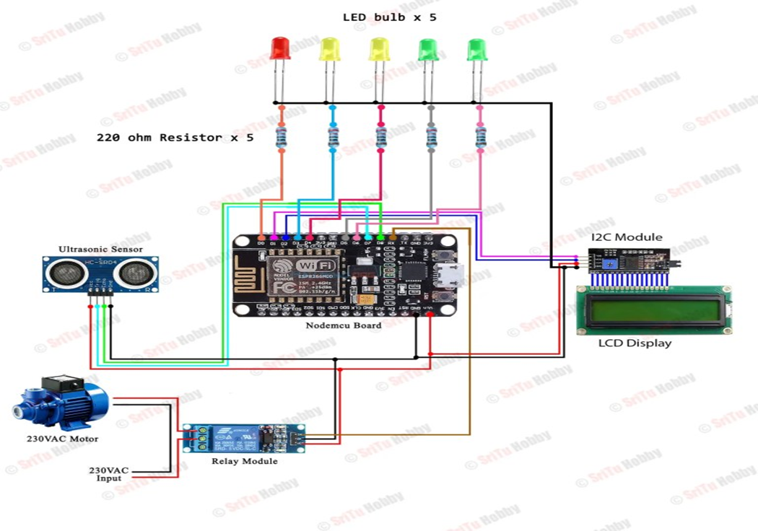
CHAPTER 5
PROJECT METHODOLOGY
The water level monitoring system consists of resistor, 5 different colours of LED, ultrasonic sensor, NODEDMCU, Relay module, lcd display, jumping wires, 12C module. These instruments are used to operate the system. The working principle of these circuits are given below.
CIRCUIT DIAGRM
Page16

Slide 17
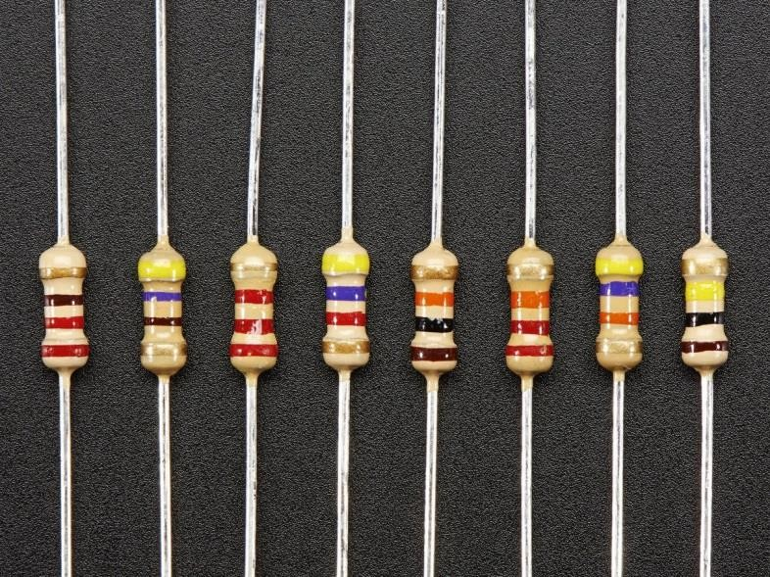
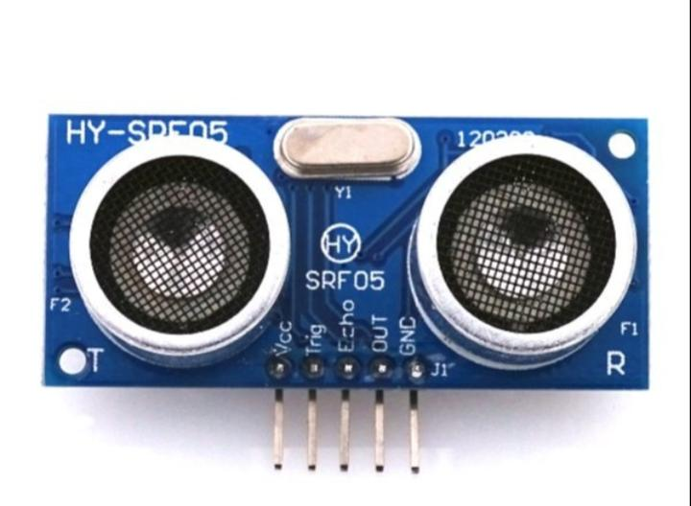
U
5.1 COMPONENTS
1. RESISTOR
Resistoris a passive component used to control current in a circuit. Its resistance is given by the ratio of voltage applied across its terminals to the current passing through it.
2. ULTRASONNIC SENSOR
Ultrasonic sensor a transducer to send and receive Ultra sonic pulses that can relay back information about the ensor is the instrument used to measures the distance to an object by using ultrasonic sound waves . Ultrasonic sensor objects proximity.
Page17
2

Slide 18
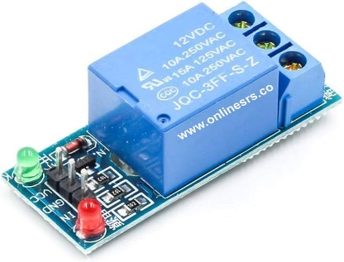
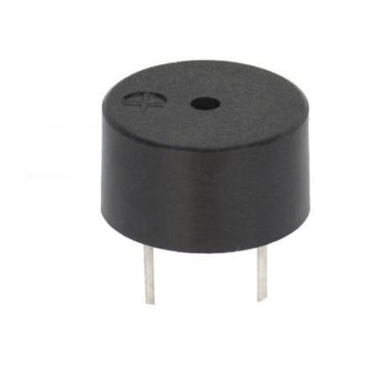
3.RELAY MODULE
A power relay module is an electrical switch that is operated by an electro magnet . The electromagnet is activated by a separate low power signal from a microcontroller . When activated , the electromagnet pulls to either open or close an electrical circuits . The relay module function is mainly to switch electrical device and system on or off. It also serves to isolate the control circuit from the devices or system being controlled.
.
4.BUZZER
A buzzer or beeper is an audio signaling device, which may be mechanical, electromechanical, or piezoelectric (piezo for short). Typical uses of buzzers and beepers include alarm devices, timers, train and confirmation of user input such as a mouse click or keystroke.
Page18

Slide 19
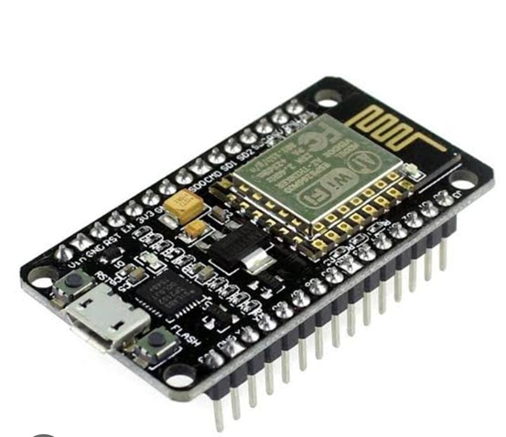

5.NODEMCU ESP8266
It has one Analog pin , 16 digital I/O pins along with the capability to connect with the serial communication product like SPI, UART, and I2C. NodeMCU has 128 KB RAM and 4MB of flash memory to store data and programs .It is extensively employed development board in IOT applicatios providing a versatile and cost effective approach to connect devices to the internet .
6.LED
LED means "Light-Emitting Diode." An LED is an electronic device that emits light when an electrical current is passed through it. LEDs are commonly used for indicator lights (such as power on/off lights) on electronic devices
Page19

Slide 20
CHAPTER 9
CONCLUSION
Most of the people in residential areas face the problem of running out of water and overflow of water in water tanks due to excess supply of water. Even when the pump is turned on users will not realize when the water tank gets filled which may result in overflow. It becomes difficult for users may run out of water, water tank monitoring system is used to sort out the issues associated with water tank. It is also possible to check the level of the water using sensor so that whenever the water goes below certain threshold limit, a notification is sent to user through the android application using Arduino Board and user needs to turn on the motor. Also if the water level goes above certain limit the motor gets turned off automatically. This system prevents wastage of water.
The study presented the design phase of water Level Monitoring System using Arduino and ultrasonic sensors. The requirement analysis and the system design details have been conducted in depth for the better understanding of the project and also to know risk factors the will be faced during the construction phase. From the above analysis we can conclude that the entire system can be built with low cost, reliable instrument there by provking an efficient Water Level Monitoring System.
Page20

Slide 21
CHAPTER 9 REFERENCS
P. Dietz , W. Yerazunis , D . Leigh, very low cost sensing and communication using bidirectional LEDs ,Ubicomp 2011: vol.2864,pp.175-191,2003.
M .Javanmard, K.A .Abbas and F. Arvin ,” A Microcontroller Based Monitoring System for Batch TeaDryer”, CCSE Journal of agriculture science , vol 1,no .2,December 2012.
Microcontroller based automated water level sensing and controlling : design and implementation issue procceding of the world congress on engineering and computer science,pp220-250.
S.M .Khaled Reza ,Shah Ahsanuzaman Md.Tariq , S.N.Mohsin Reza, ”Microcontroller based automated water level sensing and controlling : and implementation of issue :, proceeding of the world congress on engineering and computer science 2010 vol 1 (WCECS) , october 20-22,2010.
Page21

Slide 22
Web pages
[a] https://www.robotsthenextspeciesonearth.com/p/blog-page_14.html b] https://www.biz4intellia.com
[c]www.fierceelectronics.com/sensors/what-ir-sensor
Page22

